Slide 1
Life expectancy
Exploratory Data Analysis
DSC 530 (Spring 2022)
Course Project
Dipika Sharma

Slide 2
Statistical question/Hypothesis
Life expectancy means the number of years a person is expected to live based on the statistical average. There is certain variable on which life expectancy depends based on some research. As part of my course project, I am exploring some of these variables to see the correlation between them and to understand how much these variables effect the life expectancy. These data information is from World Health Organization.
I will be covering below questions while working on course project:
How is the life expectancy correlated with different variables? What factors are statistically significant for life expectancy?
Hypothesis: More than one predictor variables are affecting the life expectancy of person.
Null Hypothesis: Predictor variables are not correlated to life expectancy.
Using this assumption, we will analyze the life expectancy data and evaluate the probability of the apparent effect.
For conclusion, considering the P-value, if the P-value is low for chosen predictor variables then the null hypothesis will be true.

Slide 3
Variables
Below are the selected variables that I choose from dataset to be predictor variable along with two target variable life_expect and life_exp60.
Target Variables
life_expect - Life expectancy at birth (years)
life_exp60 - Life expectancy at age 60 (years)
Predictor Variables
bmi - Mean BMI (kg/m^2) (18+) (age-standardized estimate)
[age5-19obesity] - Prevalence of obesity among children and adolescents, BMI > (median + 2 s.d.) (crude estimate) (%)
measles - Measles-containing-vaccine first-dose (MCV1) immunization coverage among 1-year-olds (%)
polio - Polio (Pol3) immunization coverage among 1-year-olds (%)
diphtheria - Diphtheria tetanus toxoid and pertussis (DTP3) immunization coverage among 1-year-olds (%)
basic_water - Population using at least basic drinking-water services
[gghe-d] - Domestic general government health expenditure (GGHE-D) as percentage of gross domestic product (GDP) (%)

Slide 4
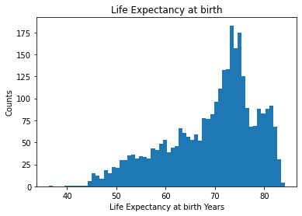
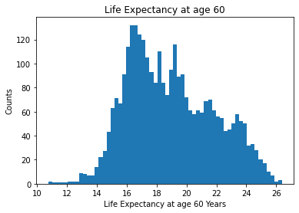
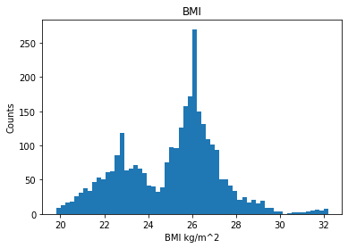
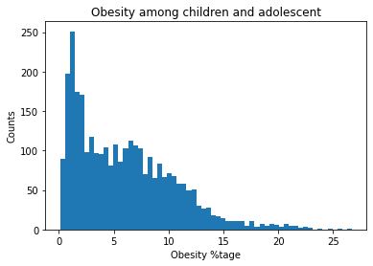
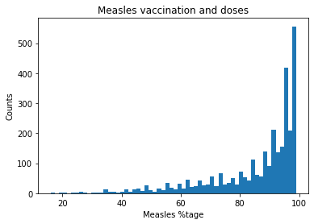
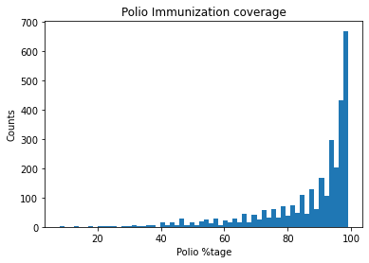
Histogram of Variables – Part 1

Slide 5
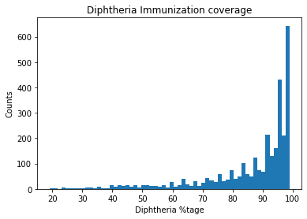
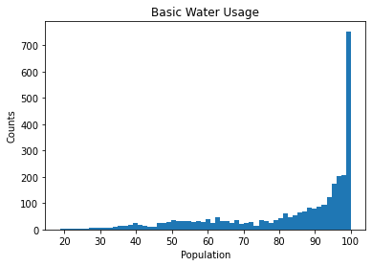
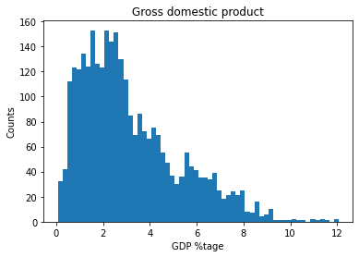
Histogram of variables – Part 2

Slide 6
descriptive characteristics of variables
 | Life expect | Life exp60 | BMI | age5-19obesity | Measles | Polio | Diphtheria | Basic water | GDP
count | 3077.000000 | 3077.000000 | 3077.000000 | 3077.000000 | 3069.000000 | 3069.000000 | 3069.000000 | 3056.000000 | 2994.000000
mean | 69.266719 | 18.936851 | 25.052714 | 5.972278 | 85.649397 | 86.696970 | 86.512545 | 83.601109 | 3.131700
std | 9.094448 | 2.890288 | 2.193445 | 4.530812 | 15.245842 | 14.905725 | 15.287155 | 19.067001 | 2.094184
min | 36.227360 | 10.728000 | 19.800000 | 0.100000 | 16.000000 | 8.000000 | 19.000000 | 18.695210 | 0.062360
25% | 63.411990 | 16.632970 | 23.300000 | 2.000000 | 80.000000 | 82.000000 | 82.000000 | 72.350650 | 1.540805
50% | 71.727020 | 18.560910 | 25.500000 | 5.200000 | 92.000000 | 93.000000 | 93.000000 | 92.273325 | 2.607355
75% | 75.592730 | 21.138660 | 26.500000 | 8.900000 | 96.000000 | 97.000000 | 97.000000 | 98.566293 | 4.290345
max | 84.166160 | 26.394020 | 32.200000 | 26.700000 | 99.000000 | 99.000000 | 99.000000 | 100.000010 | 12.062730
All the selected variables for analysis are numeric and I have used describe() and mode() function to see mean, mode, and spread of each variable.
This function will also display various properties like std, min/max values and 1st quartiles (25%), medians (50%) and 3rd quartiles (75%) values.

Slide 7
descriptive characteristics of variables
The Mode for life_expect variable is: 67.03989 years
The Mode for life_exp60 variable is: 15.18697 years
The Mode for bmi variable is: 26.0
The Mode for age5-19obesity variable is: 1.0
The Mode for measles variable is: 99.0
The Mode for polio variable is: 99.0
The Mode for diphtheria variable is: 99.0
The Mode for basic_water variable is: 100.0
The Mode for 'gghe-d' variable is: 1.08423
The Mode for une_life variable is: 80.70244 years
We can find modes of all the numeric variables above.
Mode value for life expectancy at birth is 67 years and Life expectancy at age of 60 is 15 years.

Slide 8
descriptive characteristics of variables and possible visual skew and outliers
Life Expectancy at time of birth distribution seems to be left skewed distribution but has slight positive skew at the higher end of the years. Also, we see longer tail on the left side of the plot.
Life expectancy at age of 60 has random distribution, as shown above, This plot does not have any apparent pattern like normal distribution and has several peaks.

Slide 9
descriptive characteristics of variables and possible visual skew and outliers
This graph shows two peaks one is normal distribution for bmi range between 24 kg/m^2 to 30 kg/m^2 and another peak towards the lower end of the bmi value less then 24 kg/m^2. Overall, it seems like a bimodal shape distribution.
GDP % distribution has had skewed distribution to the right. Since the distribution skewed to the right, we called it positively skewed. but this plot has more then one peak, it looks like a slight random distribution.

Slide 10
Outliers
It is recommended to use only one peak for analyzation when we encounter any bimodal distribution. So, we can drop one of the peak as an outliers and can use only BMI greater then 24 kg/m^2 for analysis. Dropping of small peak will give us normal distribution.
Although by looking at the database I found we have more then 1000 records out of total 3077 records which has less BMI value of 24 kg/m^2. This is 32 % of the total data we have for analysis, and I think it would be better to not drop the data and use all of it for analysis.

Slide 11
Outliers
Defining the IQR range to identify the outliers in target variables life_expect & life_exp60 and predictive variable BMI.
life_expect_lower = (63.411990 - (75.592730 - 63.411990) * 1.5)
life_expect_upper = (75.592730 + (75.592730 - 63.411990) * 1.5)
Life Expectancy at birth lower value for skew identification is 45.14088 years and upper value for skew identification is 93.86384000000001 years.
** Using this IQR range for life_expect, life_exp60 and bmi we can remove outliers from dataset for all these variables.
life_expect60_lower = (16.632970 - (21.138660 - 16.632970) * 1.5)
life_expect60_upper = (21.138660 + (21.138660 - 16.632970) * 1.5)
Life Expectancy at age 60 lower value for skew identification is 9.874434999999998 years and upper value for skew identification is 27.897195000000004 years.
bmi_lower = (23.300000 - (26.500000 - 23.300000) * 1.5)
bmi_upper = (26.500000 + (26.500000 - 23.300000) * 1.5)
BMI lower value for skew identification is 18.5 kg/m^2 and upper value for skew identification is 31.299999999999997 kg/m^2.

Slide 12
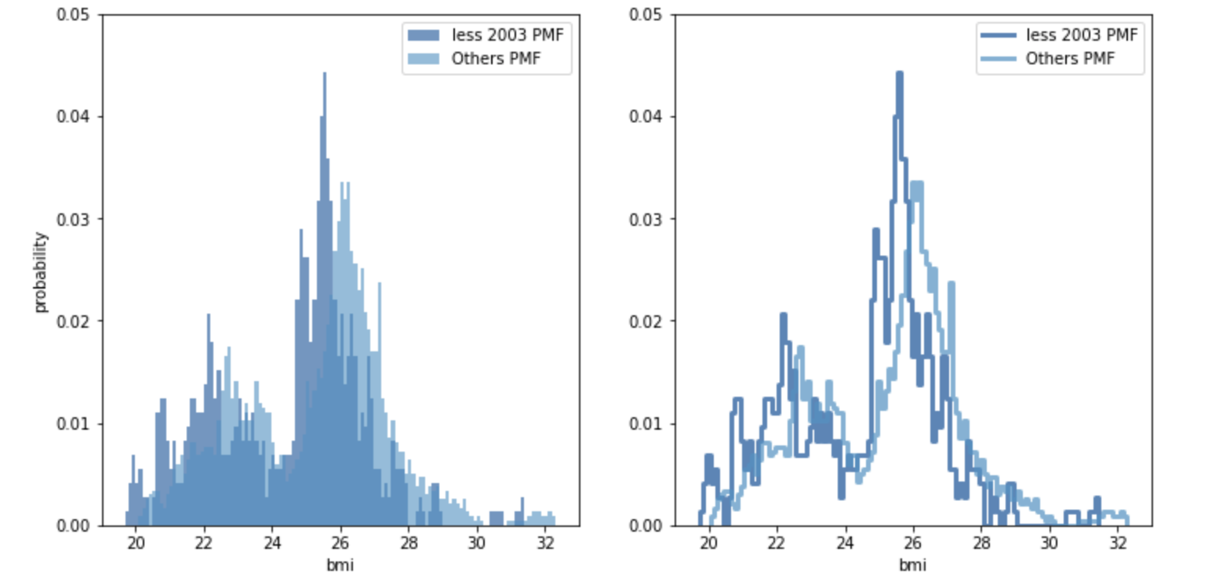
Probability Mass function for different range of years compare by bmi values
Person bmi value is more for year range less then 2003 compared to the bmi value for year range greater then 2003.
Plot shows bmi has maximum probability for bmi value 25 kg/m^2 for years before 2003.

Slide 13
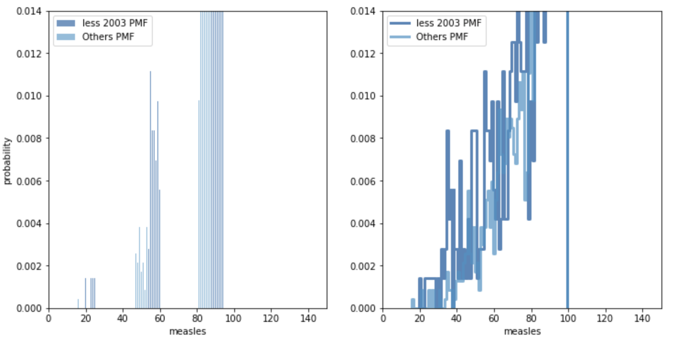
Probability Mass function for different range of years compare by Measles Percentage
The Measles immunization and doses percentage is more in year less then 2003.
We see less immunization or doses percentage rate for Measles for years greater then 2003.

Slide 14
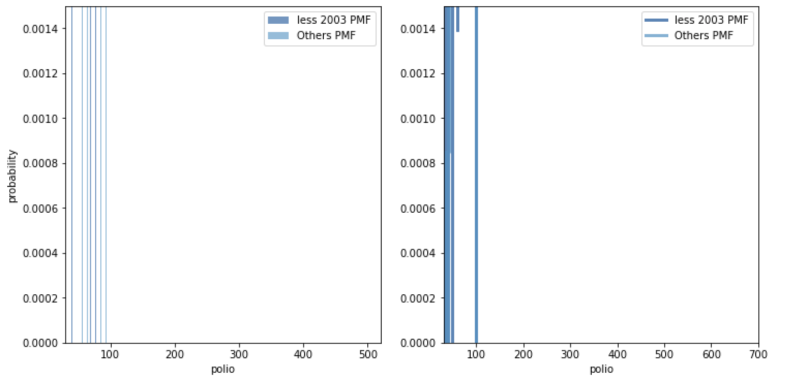
Probability Mass function for different range of years compare by Polio percentage
The Polio immunization percentage is more in pre 2003 year.
We see less immunization percentage rate for Polio for years greater then 2003.

Slide 15
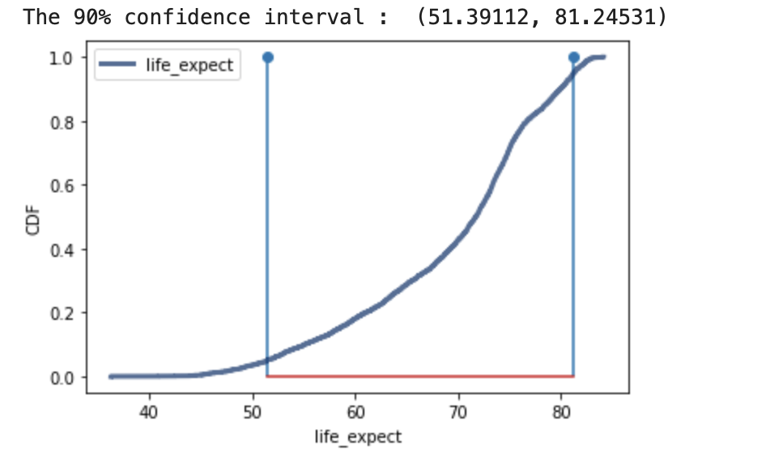
CDF Life Expectancy at Birth
CDF graph show for majority people the life expectancy at time of birth is from 51 years (5%) to 81 years (95%).
This graph shows the life expectancy at time of birth is mostly expected to be greater then 51 years.

Slide 16
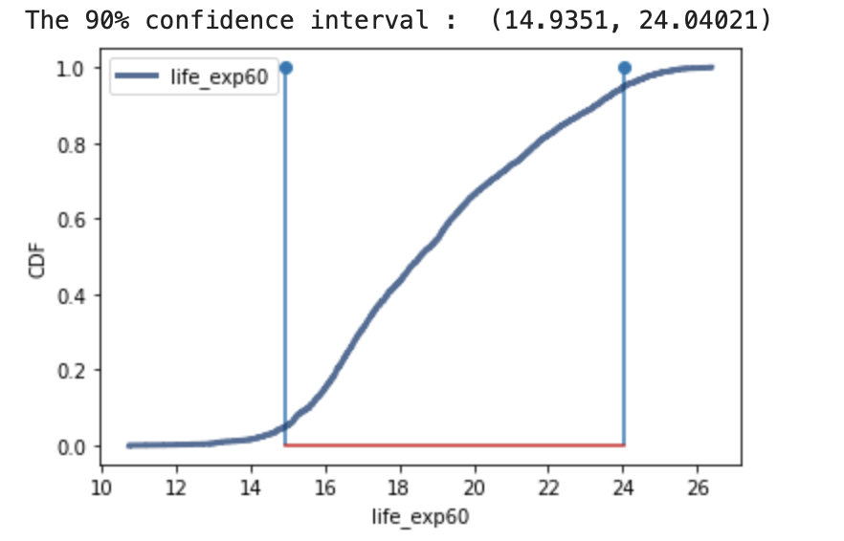
CDF Life expectancy at age 60
CDF graph show for majority people the life expectancy at age 60 is from 15 years (5%) to 24 years (95%).
This graph shows the life expectancy at age 60 mostly expected to be greater then 15 years.

Slide 17
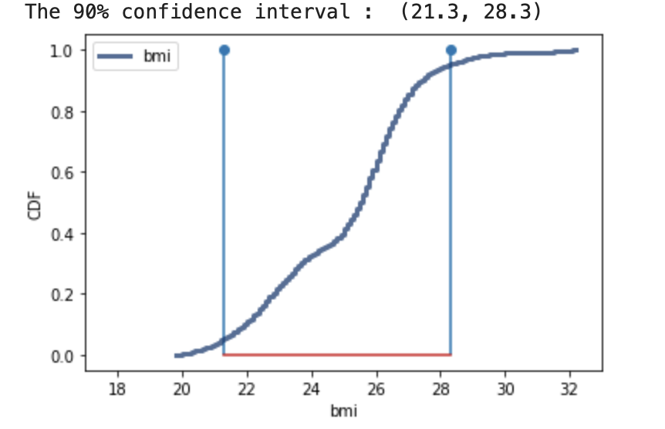
CDF – Bmi values
CDF graph show for majority people the BMI value is from 21.3 kg/m^2 (5%) to 28.3 kg/m^2 (95%).
This graph shows that mostly the BMI value expected to be greater then 21.3 kg/m^2.

Slide 18
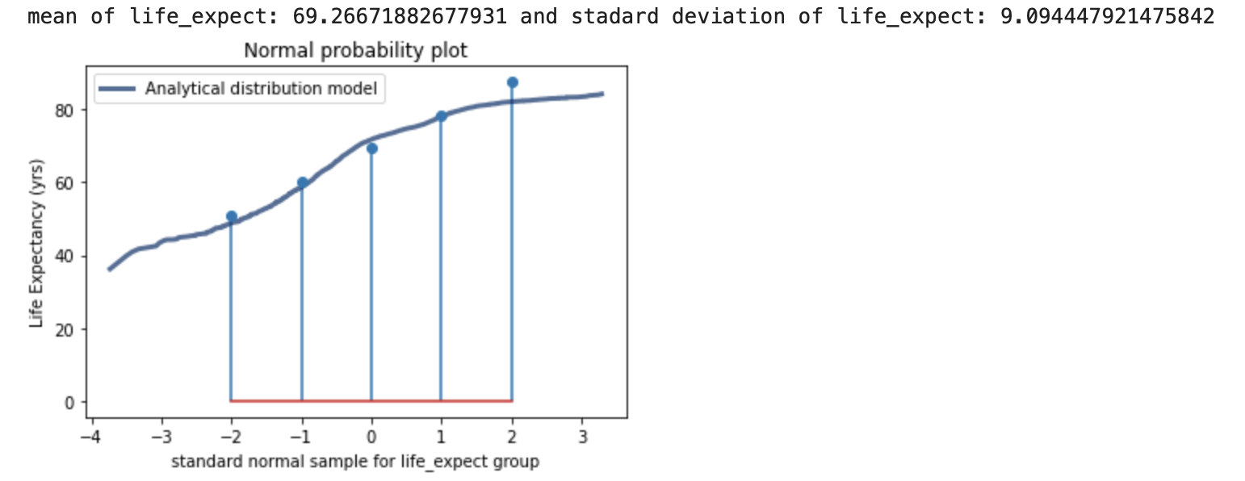
Analytical Distribution of Life expectancy at birth
The Life expectancy at birth mean is 69 years and the standard deviation is 9.
This show the analytical distribution for life expectancy at birth is from 51 years to 81 years.

Slide 19
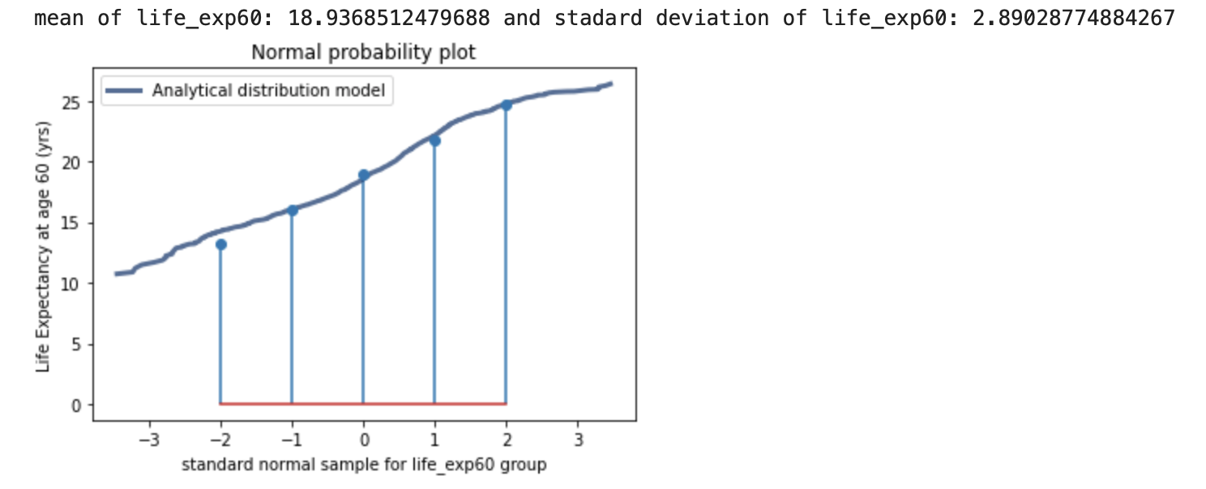
Analytical Distribution of life expectancy at age 60
The Life expectancy at age 60 mean is 18 years and the standard deviation is 2.
This show the analytical distribution for life expectancy at age 60 is from 14 years to 24 years.

Slide 20
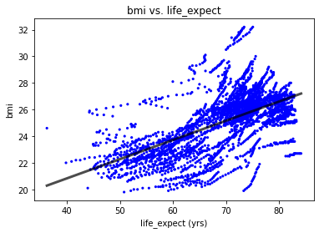
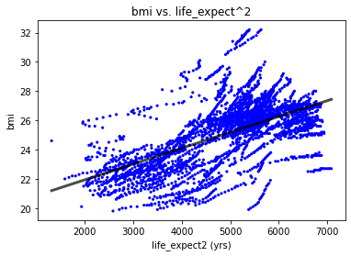
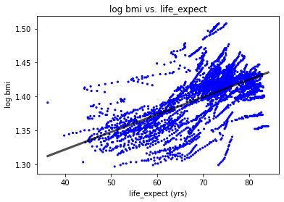
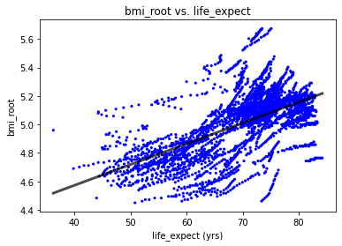
Scatter plot comparing two variables
Plot 1 - Scatter plot of bmi vs life expectancy at birth is weak positive linear association. The line is difficult to detect when the relationship is weak.
Plot 2 - Scatter plot of bmi vs life expectancy squared at birth look quite similar to plot 1. this plot also has weak positive linear association.
Plot 3 – The Scatter plot of log10 bmi vs life expectancy at birth also show weak positive linear association.
Plot 4 - Scatter plot of square root of bmi vs life expectancy at birth is weak positive linear association.

Slide 21
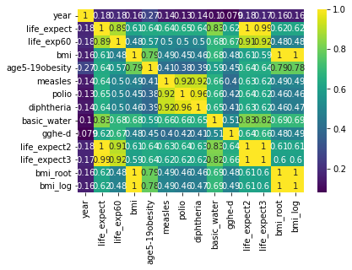
Correlation Analysis between variables
Looking at the correlation between all the variables we can say that life_expect and cube of life_expect has strong relationship.
Measles, poilio and diptheria also has strong relationship.
Basic_water is also strongly related to squared life_expect and cube of life_expect variable.
We can create model using ay of these variable.

Slide 22
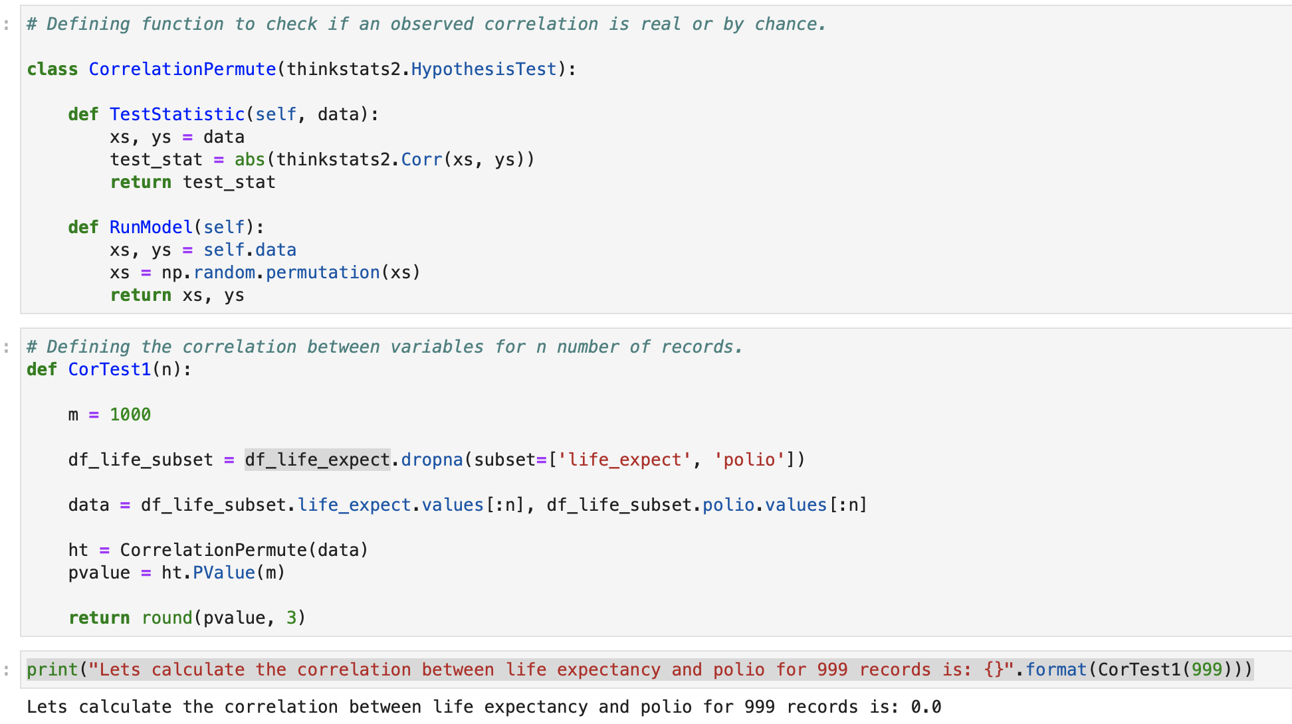
Hypothesis Testing
The above show p-value 0 which shows that we do not see any correlation between life expectancy and polio for 1000 trials. It is a possibility that p value is less then 1/1000 and not zero.
With 1000 trial we exceeds the observed correlation under the null hypothesis.

Slide 23
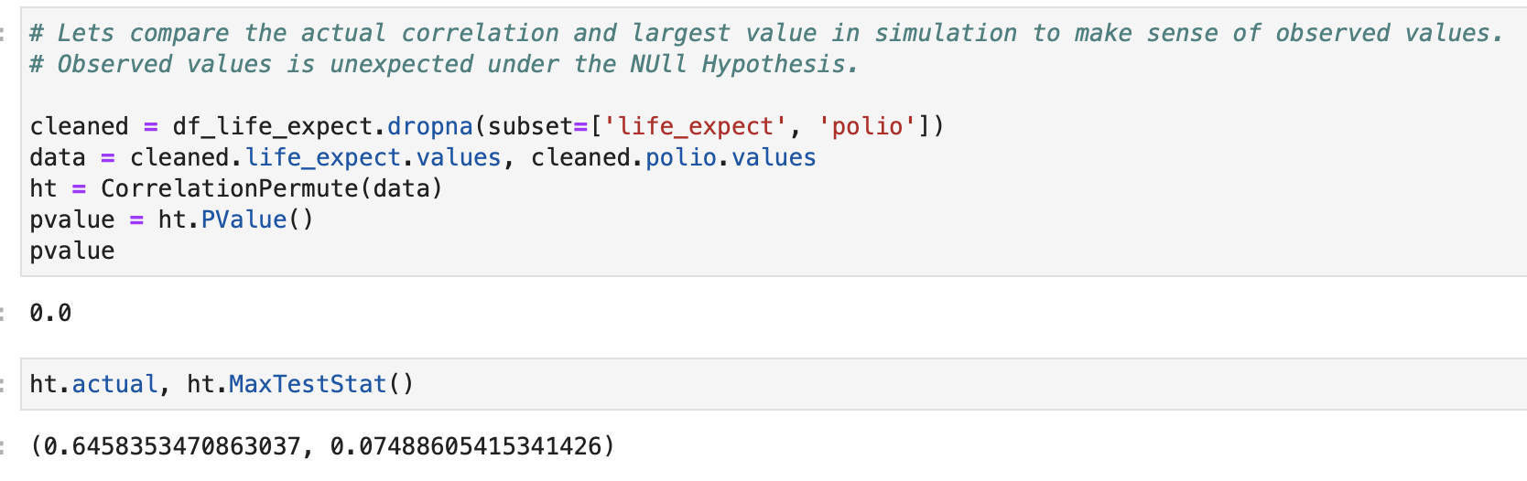
Hypostesis Testing
We have already seen in the last slide that the computed p-value is 0 but here the actual correlation is 0.6.
Also, the largest simulated correlation after 1000 iterations is 0.07.
The observed correlation is small, but it is statistically significant.

Slide 24
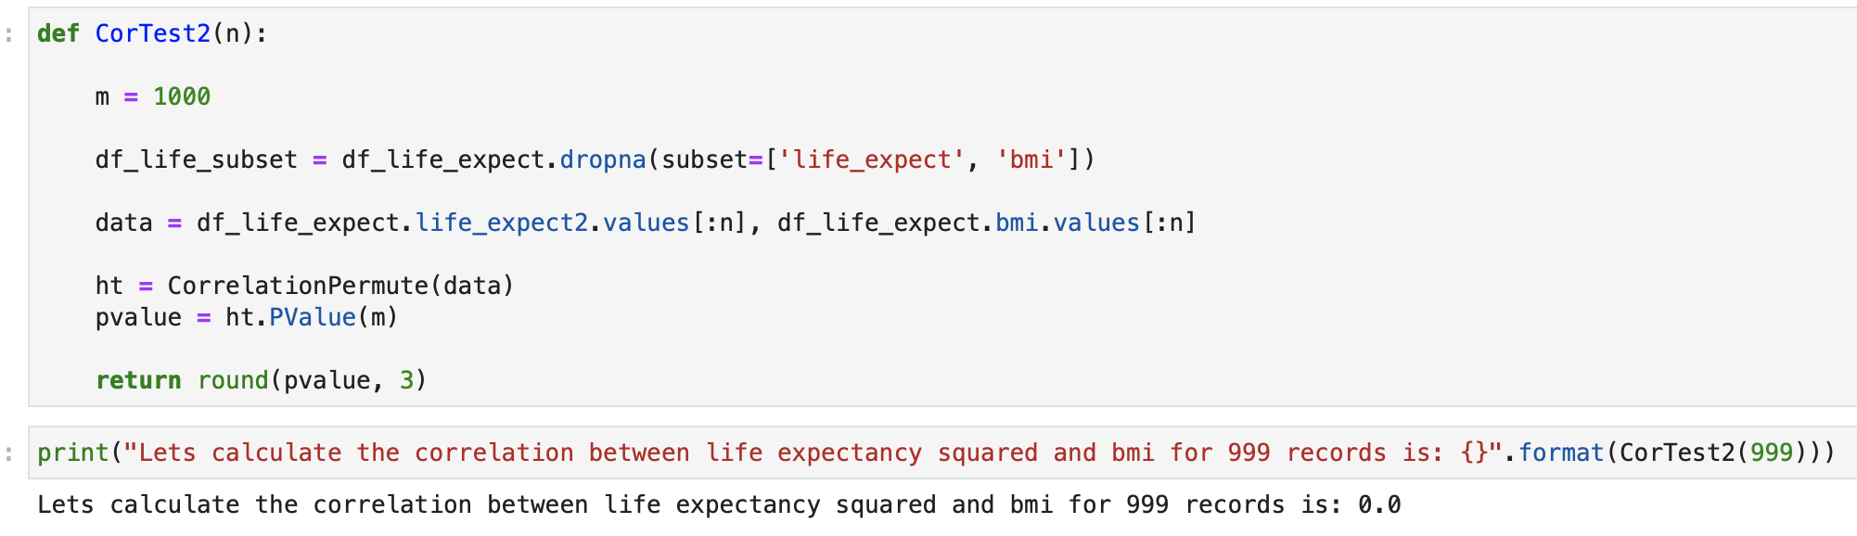
Hypothesis Testing
The above show p-value 0 which shows that we do not see any correlation between life expectancy and bmi for 1000 trials. It is a possibility that p value is less then 1/1000 and not zero.
With 1000 trial we exceeds the observed correlation under the null hypothesis.

Slide 25
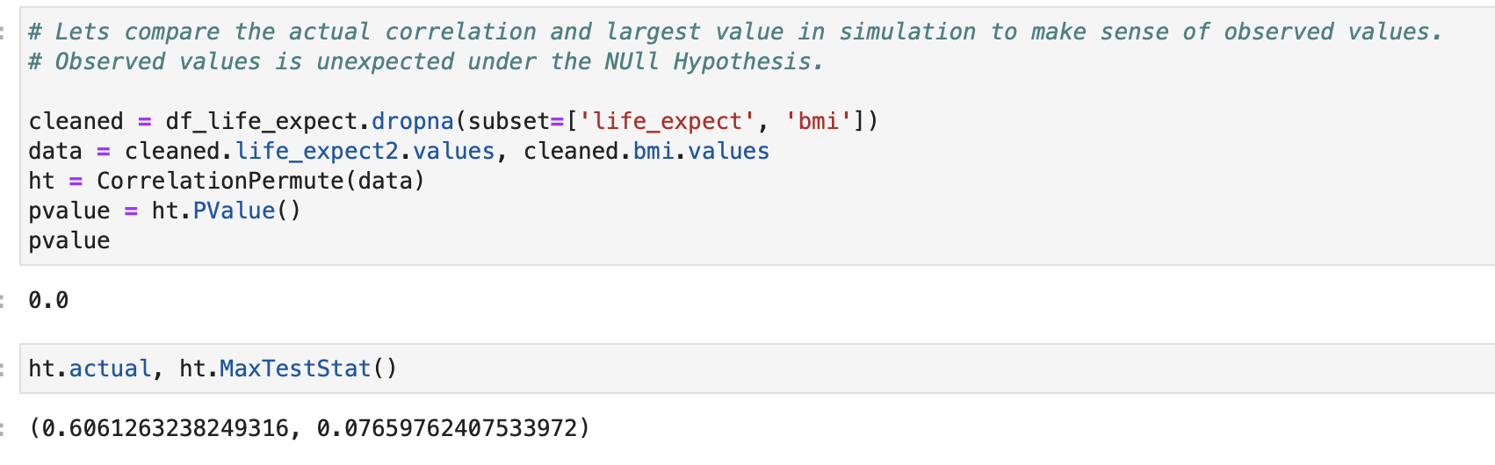
Hypothesis Testing
We have already seen in the last slide that the computed p-value is 0 but here the actual correlation is 0.6.
Also, the largest simulated correlation after 1000 iterations is 0.076.
The observed correlation is small, but it is statistically significant.

Slide 26
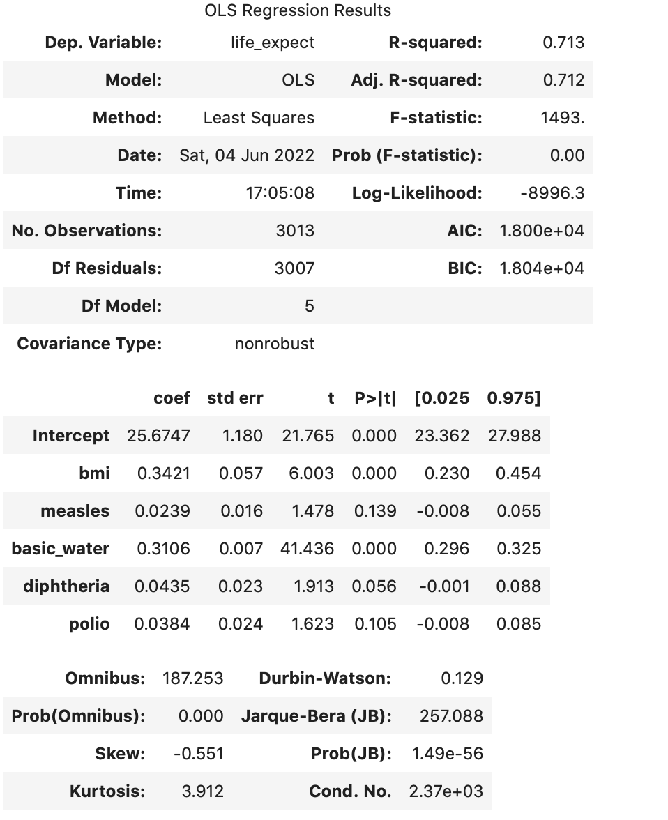
Regression Analysis
As we can see the outcome of OLS function from statsmodel. We can find following from the regression results:
The R-squared value is between 0 to 1 so the created model is a fit. Higher R-squared values represent smaller differences between the observed data and the fitted values.
The std err variable is very low which means the selected model is accurate.
The p-value is 0 which is considered to be statistically significant.
The skew is -0.551 that is negative skew indicating longer tail on the left side.
Kurtosis value is 3.912 which is greater then 0, it means that the tail of the distribution is thicker and pointy.

